Slide 1

Project Horizon 2020
Institut Supérieur D‘Informatique
Course: IT Project Management Tools & Techniques Professor: Christelle Faivre
Group 3:
Simranjit Singh
Palak Vaishnav
Manan Trivedi

Slide 2
Agenda
Context & Objective
Constraints & Assumptions
Project Charter
Organization Chart
Project Budget
WBS & PBS
Stakeholders Analysis
Project Schedule & Planning
Project Gantt Chart
Project Resource Plan
Risk Register & Issue Register
Communication Plan

Slide 3
Context & Objective
Context
Upgrade the server capacity to support 1000 clients at a time.
New platform based on the Java technology.
Objective
Functional portal allow users access at their convenience (24 hours a day, 7 days a week).
User & Maintenance document.
Go live date : October 5th 2020

Slide 4
Constraints & Assumptions
Constraints
Project to be complete by October 5th, 2020.
Follow sequentially approach : Hardware Setup – Application Setup – Migration – Go Live
Assumptions
All the required team members are assigned this project.
Four servers are purchased by the company with help of third party Data Center provider. The site survey, power cabling, network cabling will be done by the server provider, already included in the initial price.
Network links established between Montreal & Dallas already completed by third party.
Assessment & Risk Analysis and Site survey is already completed by external consultancy firm.
Project Manager is an external consultant that is hired to handle this project under supervision of CIO.

Slide 5
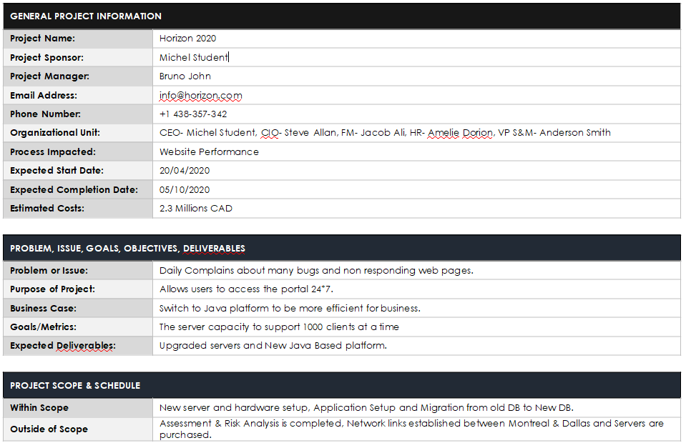
Project Charter

Slide 6
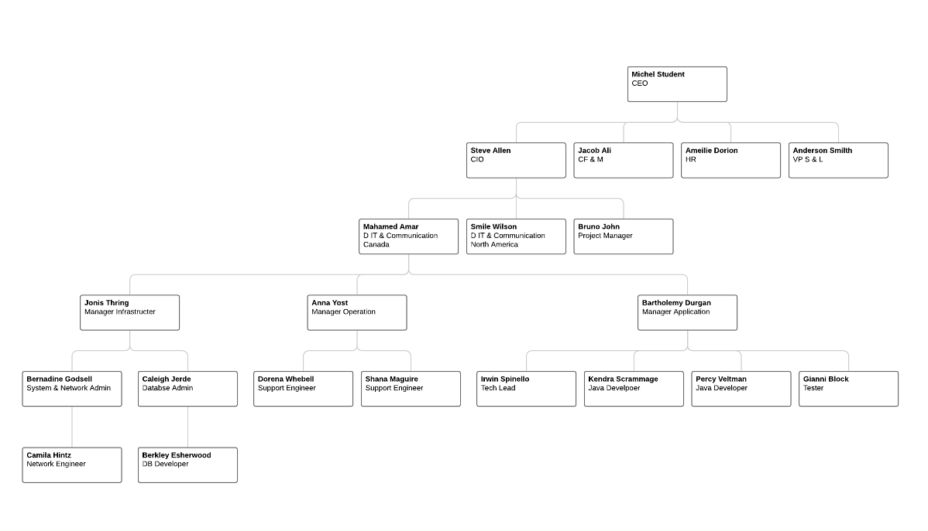
Organization Chart

Slide 7
Project Budget
Start Date | End Date | Duration | Cost
20th April 2020 | 05th October 2020 | 111 Days | $230,760/-

Slide 8
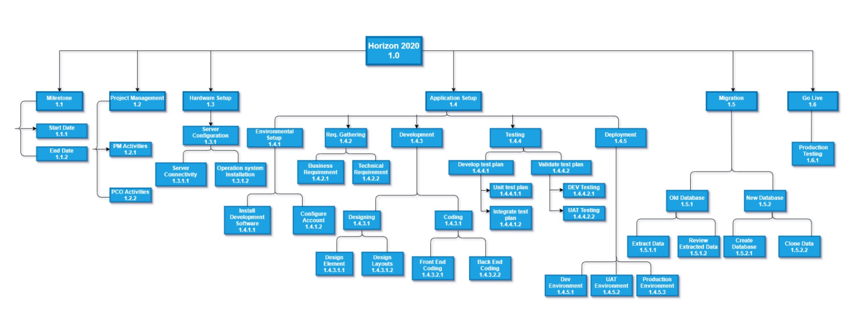
WBS

Slide 9
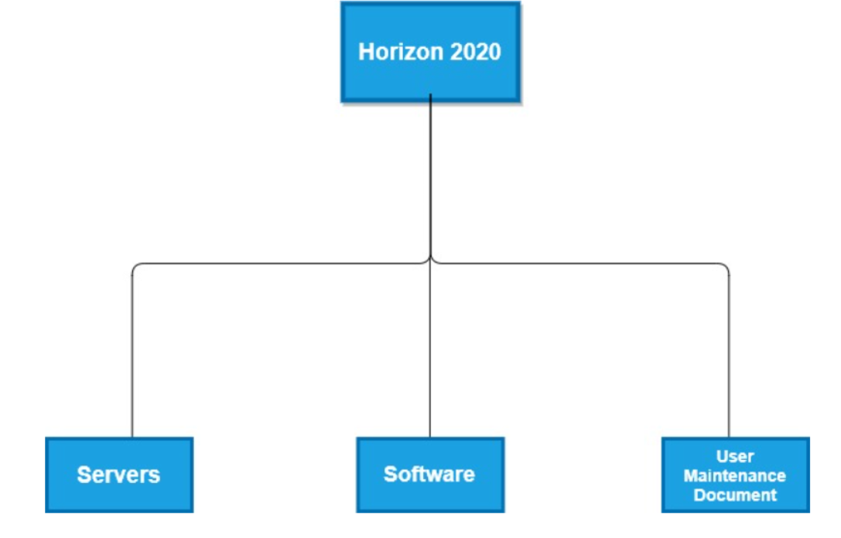
PBS

Slide 10
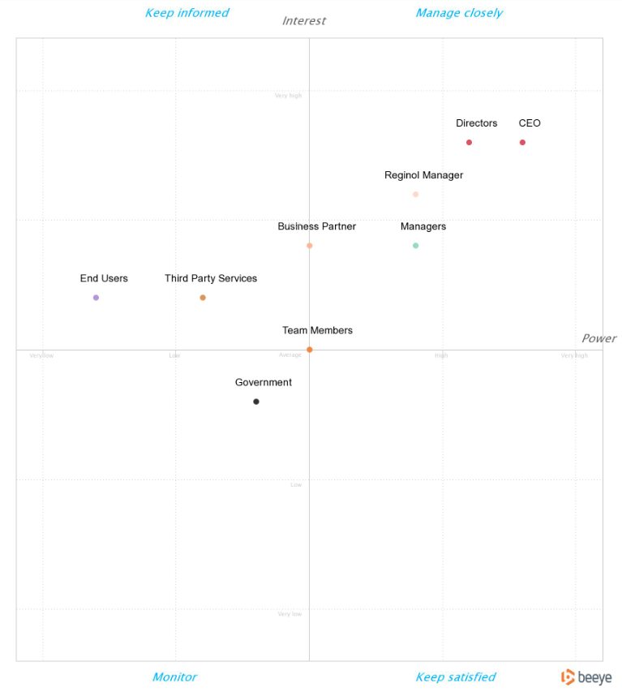
Stakeholders Analysis

Slide 11
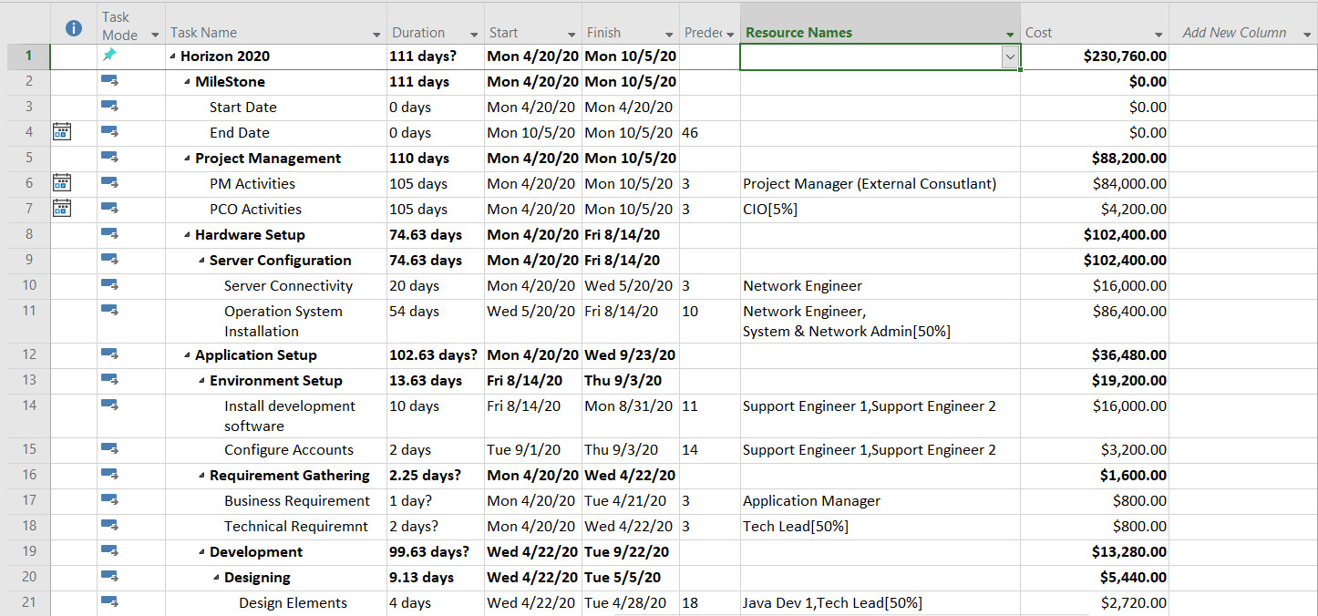
Project Schedule & Planning

Slide 12
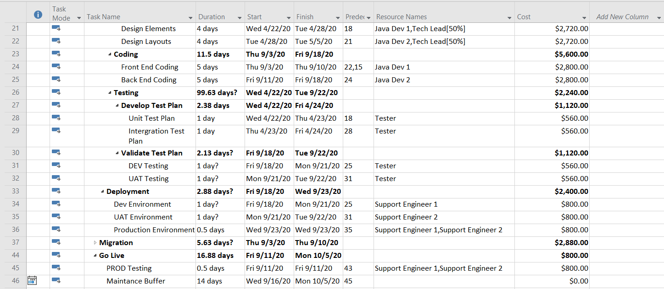
Project Schedule & Planning

Slide 13
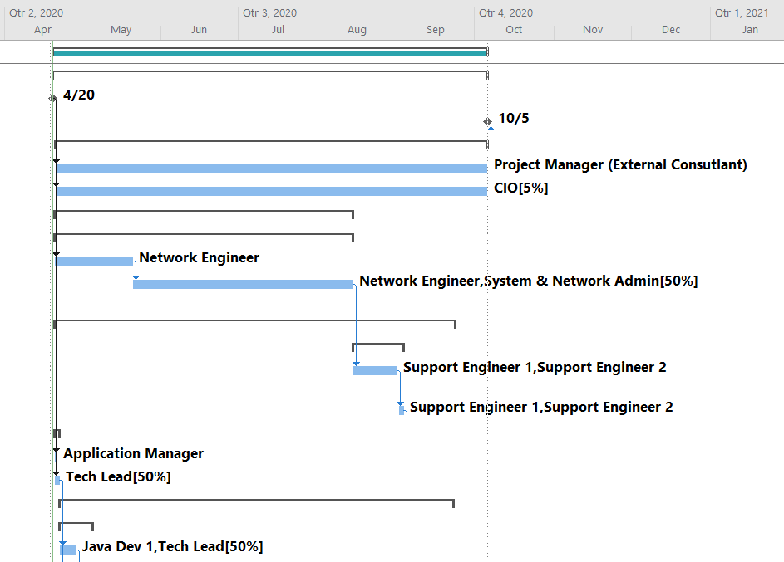
Project Gantt Chart

Slide 14
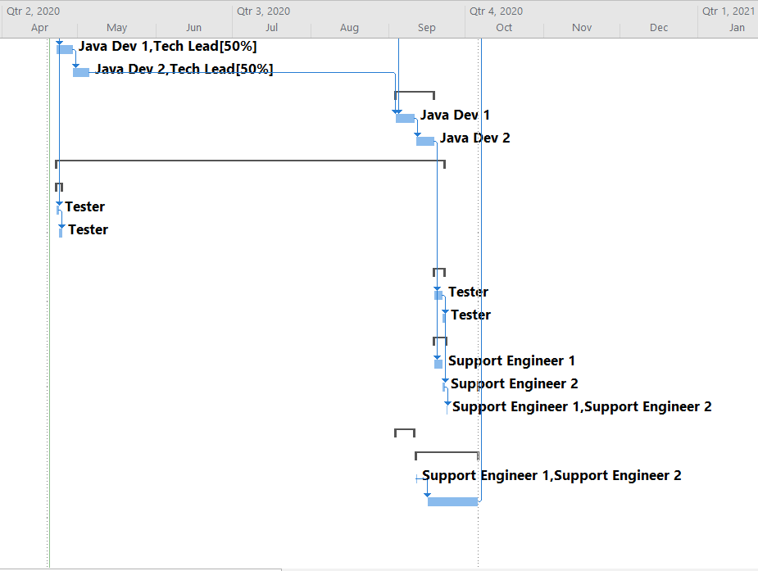
Project Gantt Chart

Slide 15
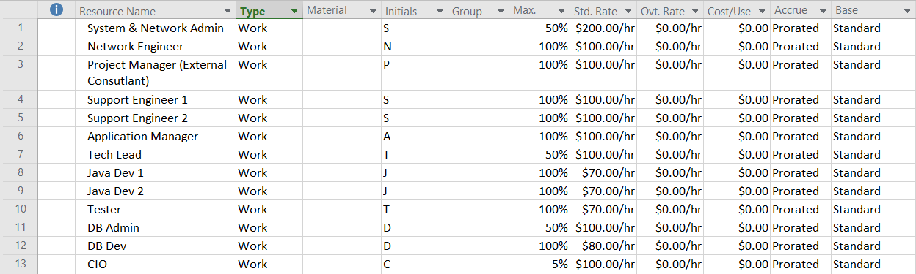
Project Resource Plan

Slide 16
Risk Register
S.No. | RISK EVENT | POTENTIAL CAUSE | DESCRINTION | PROBABILITY | RISK IMPACT CATEGORY | IMPACT | RESPONSE | RESPONSE | RESPONSIBILITY
1 | Over heating in server room | System Failure | Air-Conditioning system in both data center are old. So , if temperature of the of the server room not maintained the chance of the all services will be not available for the at least some hours. | High | Cost | Major | Transfer | Improve the air conditioning system at data center. | Datacenter Provider
2 | Physical firewall and gateway can be failed | Network Failure | Due to network failure there are chance to the data lost of the customer | Low | Quality | Major | Transfer | resolve the connectivity issue or might reqire server reboot. | Datacenter Provider
3 | Malicious Human (Interference) – DDOS Attack | Privacy Security | Due to cyber attack customer privacy data should be lost like banking information. | Medium | Safety | Major | Reduce | Firewall should be configure should be properly and also has good DDOS migration. | Application Manager & Datacenter Provider
4 | Accidental human interference – Accidental file deletion | Data lost | Due to file deletion during the backup of the database critical data could be lost. | Low | Safety | Minor | Contingency | Continue monitoring permission changes and regularly user data backups. | DB Admin
5 | Nature Disaster | All Services will be not available | Due to flooding and other nature disaster their will will chance of the power cut for some days and hours if will impact the data center for the provide all services to the customer | Low | Safety | Moderate | Passively Accept | Monitor the weather forecast. | Project manager

Slide 17
Issue Register
Issue No. | Description | Priority (H,M,L) | Category | Reported By | Assigned To | Status | Raised Date | Resolved Date | Comments
1 | Home Page loading time | M | UAT Test | Tester | Dev2 | In-Progress | NA | NA | NA
2 | Content Mismatch | L | UAT Test | Tester | Dev1 | In-Progress | NA | NA | NA
3

Slide 18
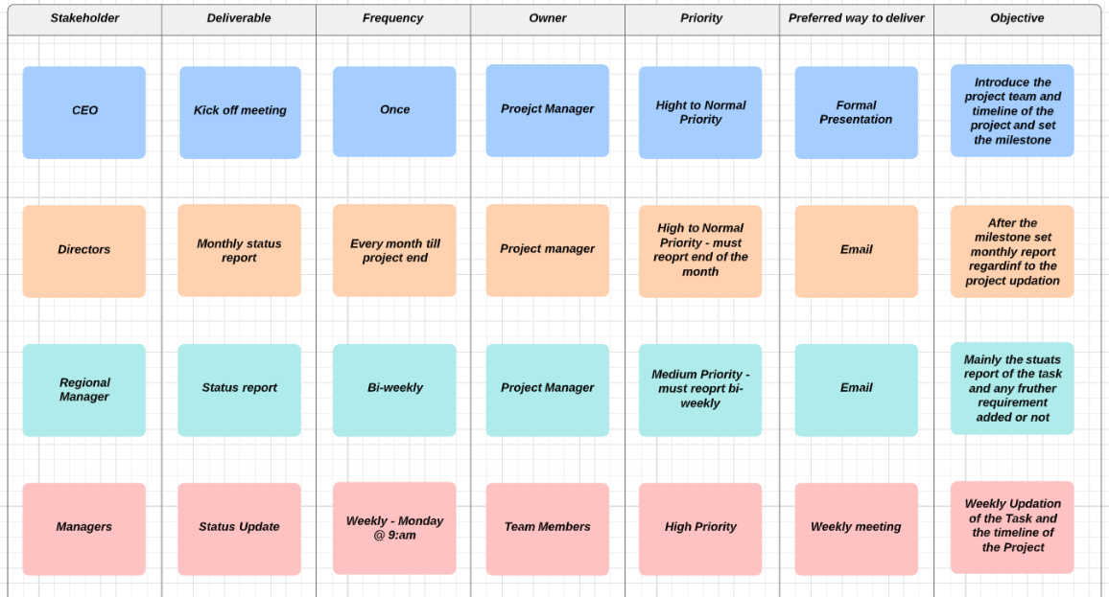
Communication Plan

Slide 19
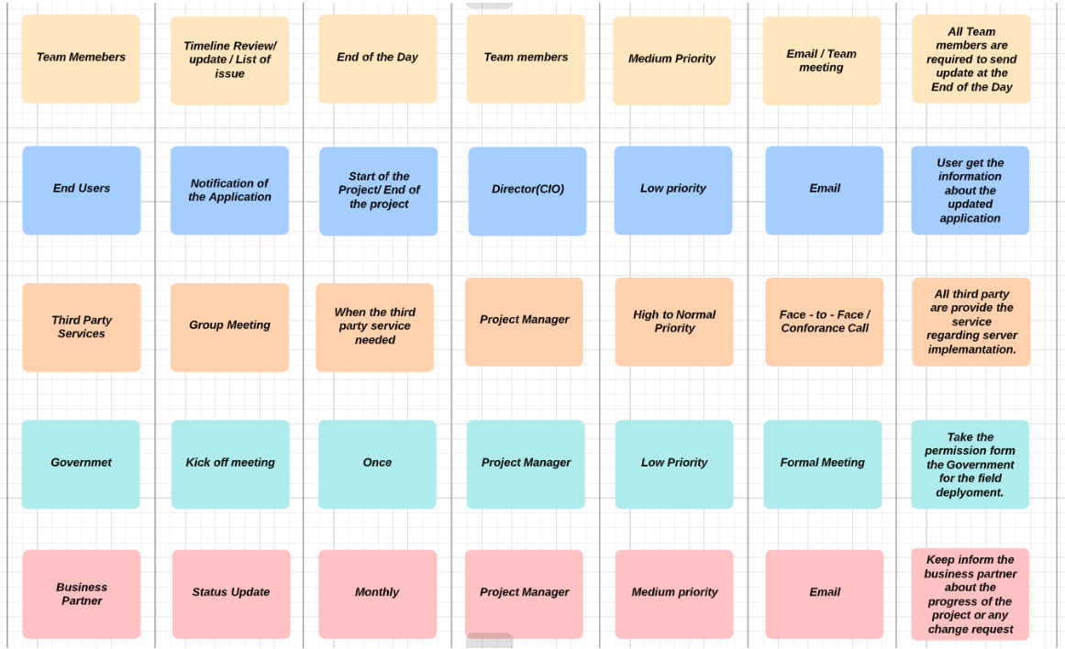
Communication Plan

Slide 20
Thank YOU…

